Slide 1
Mitigating Unfairness and Bias in Cold Start Recommenders
By Team 17
Kumsetty Nikhil Venkat - 181IT224
Amith Bhat Nekkare - 181IT105

Slide 2
INTRODUCTION
The widely used recommendation algorithms can indeed produce unfair recommendations toward different items (like job candidates of different genders).
The main driver of unfairness is the data bias in historical feedback (like clicks or views), and recommendation algorithms unaware of this bias can inherit and amplify this bias to produce unfair recommendations.
We show that the data bias can be transferred from warm start items to new items through item content features by machine learning based cold start recommendation algorithms, inducing unfair recommendations among these new items.

Slide 3
Issues and Challenges
To understand the functioning of a cold start recommendation system.
The fairness gap can be especially problematic since unfairness introduced by cold start recommenders will be perpetuated and accumulated through the entire life cycle of an item, resulting in growing difficulty for mitigating unfairness as the life cycle goes on.

Slide 4
Motivation
To create an equitable recommender system which gives fair recommendations to users even when there is no input about the users’ preferences.

Slide 5
LITERATURE SURVEY
Paper & Author | Work Done
Toshihiro Kamishima, S Akaho, H Asoh, and J Sakuma. 2018. Recommendation Independence. In Conference on Fairness, Accountability and Transparency | Focused on rating prediction tasks and investigate item fairness by measuring the difference of predicted rating distributions across item groups and regularization-based innovations
Weiwen Liu and Robin Burke. 2018. Personalizing fairness-aware re-ranking. arXiv preprint arXiv:1809.02921 (2018) | Directly studied the item fairness on ranking results instead of on the intermediate predicted scores/ratings
Ziwei Zhu, Xia Hu, and James Caverlee. 2018. Fairness-aware tensor-based recommendation. In Proceedings of the 27th ACM International Conference on Information and Knowledge Management. 1153–1162 | Studies the equal opportunity based fairness concept that requires an equal true positive rate across item groups
Ziwei Zhu, Jingu Kim, et al. 2021. Fairness among New Items in Cold Start Recommender Systems. In Proceedings of the 44th International ACM SIGIR Conference on Research and Development in Information Retrieval. | Introduced the innovation of cold start recommender systems

Slide 6
OUTCOME OF LITERATURE REVIEW
In our literature review, we found that most papers in the domain of recommender systems focussed on improving fairness in scenarios where unfairness arises due to biased prior user-feedback history (like clicks or views). Hence, unfairness in systems which do not have any user data was not explored till now.

Slide 7
PROBLEM STATEMENT
To show the prevalence of unfairness in cold start recommender systems and develop a learnable post-processing model for enhancing fairness of the recommender system, especially in the absence of user feedback data.

Slide 8
METHODOLOGY
Develop a model to learn a transformation from item content feature of warm start items to user-item interactions between warm start users and items during training.
Apply the learned transformation process to the content feature of a new item to predict the possible interactions between users and new items as a recommendation during testing.
For this purpose we will use mainly 2 types of approaches
Joint-learning Generative Method
Score Scaling Method

Slide 9
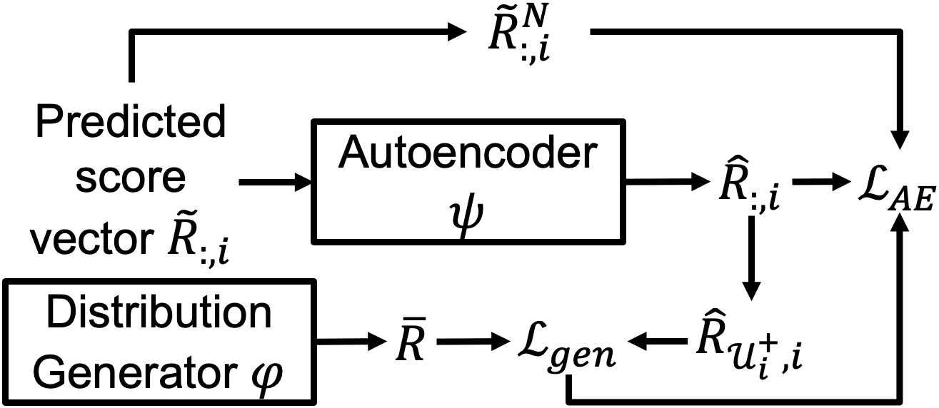
METHODOLOGY
Joint-learning Generative Method:

Slide 10
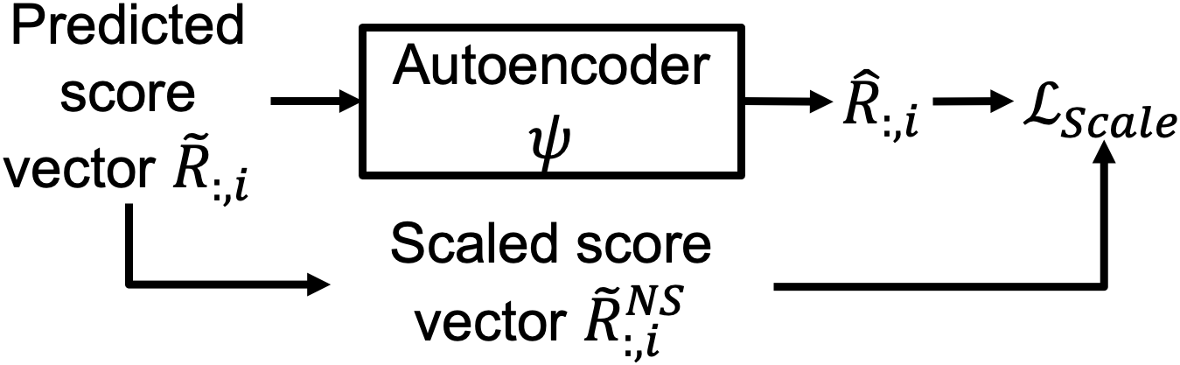
METHODOLOGY
Score Scaling Method:

Slide 11
WORK DONE - Gen Model
For the mid-sem evaluation, we have implemented the joint-learning generative model. It was run on the ML1M benchmark dataset.
15 30 200
Curr test recall 0.230553 0.354696 0.782695
Curr test precision 0.479451 0.399922 0.168609
Curr test ndcg 0.535443 0.518525 0.625817

Slide 12
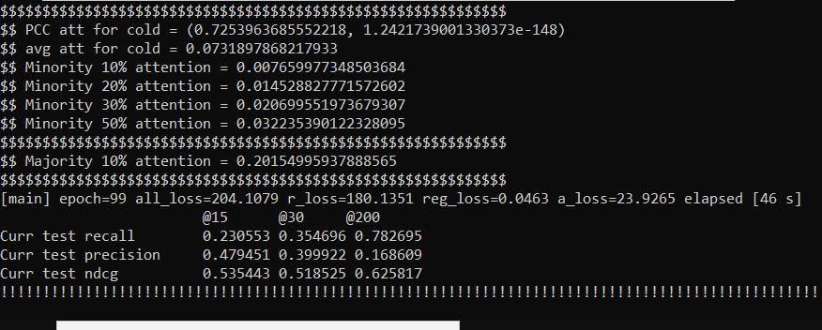

Slide 13
WORK DONE - Scale Model
For the end-sem evaluation, we have implemented the joint-learning generative model. It was run on the ML1M benchmark dataset.
15 30 200
Curr test recall 0.228791 0.352389 0.784610
Curr test precision 0.471120 0.394472 0.171176
Curr test ndcg 0.528151 0.513501 0.625947

Slide 14
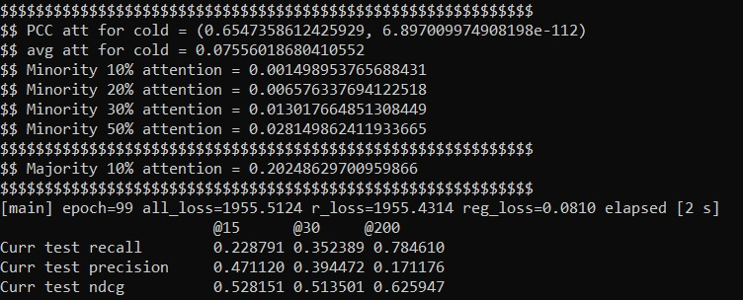

Slide 15
Individual Contributions
Data Preprocessing on ML1M dataset - Amith Bhat
Implementing Joint-learning generative model to reduce the unfairness in cold start recommendation system- Amith Bhat
Implementing score scaling model to reduce the unfairness in cold start recommendation system - Nikhil Venkat

Slide 16
FUTURE WORK
Build a heater cold-start recommendation system, so as to apply this model in real-world context.
Implement this model on other datasets such as CiteULike, etc. (dataset recording user preferences toward scientific articles)

Slide 17
References
Ziwei Zhu, Jingu Kim, Trung Nguyen, Aish Fenton, and James Caverlee. 2021. Fairness among New Items in Cold Start Recommender Systems. In Proceedings of the 44th International ACM SIGIR Conference on Research and Development in Information Retrieval (SIGIR '21). Association for Computing Machinery, New York, NY, USA, 767–776. DOI:https://doi.org/10.1145/3404835.3462948 (BASE PAPER)
Ziwei Zhu, Jianling Wang, and James Caverlee. 2020. Measuring and Mitigating Item Under-Recommendation Bias in Personalized Ranking Systems. In Proceedings of the 43rd International ACM SIGIR Conference on Research and Development in Information Retrieval. 449–458.

Slide 18
Thank You

